Slide 1
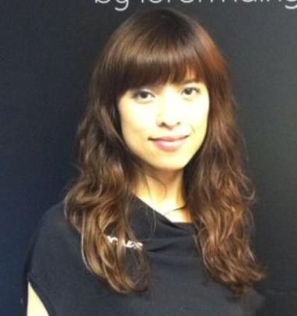
Lumière de Vie™引領護膚美麗革命
Lumière de Vie Leads the Skincare Revolution
Rose Wong
顧問經理級經銷商 Supervising Coordinator
四個佣金週期共賺取HK$57,500
HK$57,500 in 4 Commission weeks
本簡報中提到的收入等級純屬舉例說明，無意代表美安香港經銷商的一般收入，也無意表示任何經銷商皆可賺取同等收入。美安香港經銷商的成功與否，取決於其在發展事業時的努力、才能與投入程度。The income levels mentioned in the following presentation are for illustration purposes only. They are not intended to represent the income of a typical Market Hong Kong Distributor, nor are they intended to represent that any given Independent Distributor will earn income in that amount. The success of any Market Hong Kong Independent Distributor will depend upon the amount of hard work, talent, and dedication which he or she devotes to building his or her Market Hong Kong Business.

Slide 2
極緻妍亮護膚系列

Slide 3
Put life and light into your skin with Lumière de Vie
Lumiére de Vie
極緻妍亮護膚系列
激活肌膚散發傳奇亮澤的奧秘

Slide 4
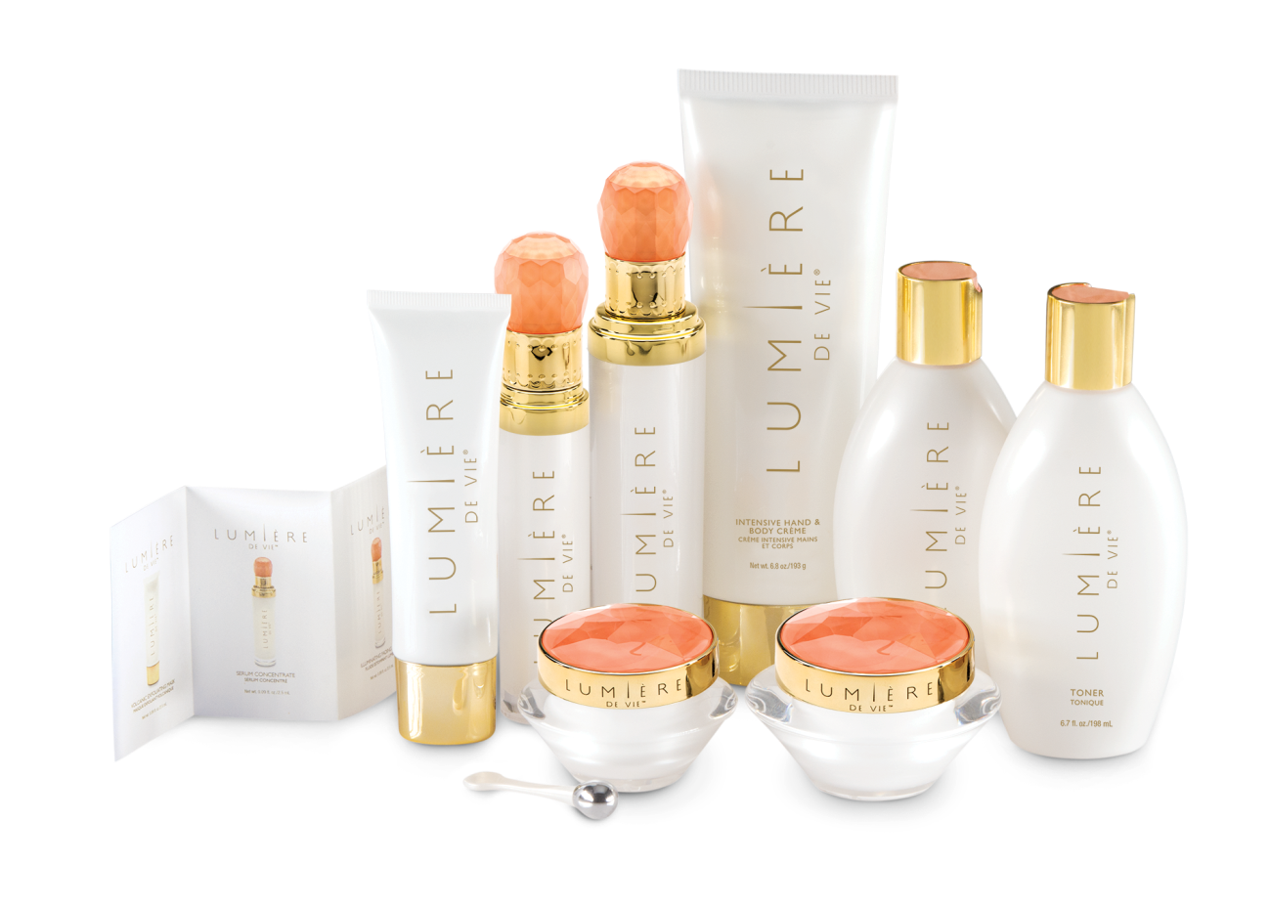

Slide 5
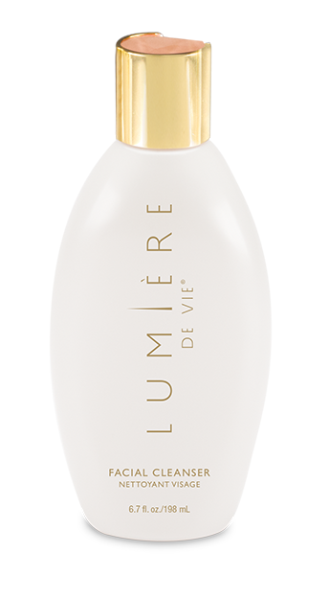
極緻妍亮潔面乳 Facial Cleanser
主要成份：
泛醇
尿囊素
KEY INGREDIENTS:
Panthenol (Vitamin B5)
Allantoin
Code: HK12207 DC: $210 SR: $293 BV: 20

Slide 6
極緻妍亮潔面乳 Facial Cleanser
效果：
去角質並潔淨毛孔，清除污垢及多餘油脂
徹底潔淨肌膚，為肌膚注入再生活力
含草本萃取物，令肌膚潔淨透亮，並撫平粗糙外表
有助修復受損肌膚
Results you can expect:
Exfoliates skin to cleanse pores and remove impurities and excess oils
Thoroughly cleanses the skin, leaving it feeling refreshed and invigorated
Contains botanical extracts that clarify skin and smooth rough texture
Promotes healing of damaged skin
Code: HK12207 DC: $210 SR: $293 BV: 20

Slide 7
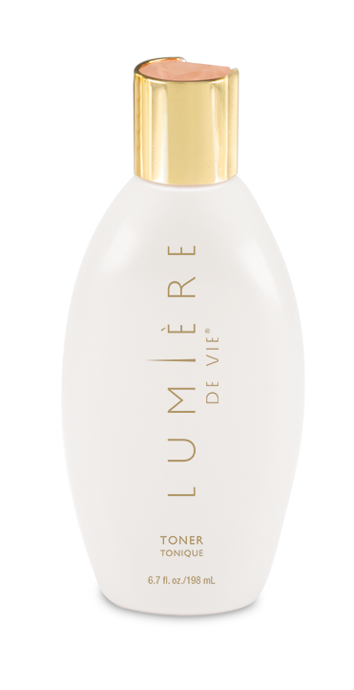
極緻妍亮爽膚水 TONER
主要成份：
乳酸
尿囊素
KEY INGREDIENTS:
Lactic Acid
Allantoin
Code: HK12208 DC: $185 SR: $260 BV: 18

Slide 8
極緻妍亮爽膚水 TONER
效果：
有助改善肌膚粗糙和乾燥外表，令肌膚外表更柔軟嫩滑
支援健康的肌膚含水量，令肌膚散發年輕光彩
獨特平衡酸鹼值配方，修復肌膚化學狀態─潔面後的重要步驟
Results you can expect:
Helps to reduce the appearance of rough, dry skin, leaving it looking softer and smoother
Supports healthy skin hydration, for a younger-looking, radiant complexion
Restores skin chemistry with a unique pH balanced formula – essential after cleaning
Code: HK12208 DC: $185 SR: $260 BV: 18

Slide 9
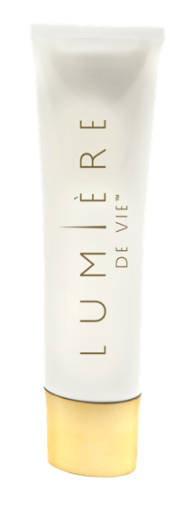
極緻妍亮火山泥去角質面膜
VOLCANIC EXFOLIATING MASK
主要成份：
PerfectionPeptide P3
火山泥（浮石）
尿囊素
乳酸
甜杏仁油
KEY INGREDIENTS:
PerfectionPeptide P3
Volcanic Sand (Pumice)
Allantonin
Lactic Acid
Sweet Almond Oil
Code: HK12202 DC: $305 SR: $425 BV: 32

Slide 10
極緻妍亮火山泥去角質面膜
VOLCANIC EXFOLIATING MASK
效果：
尿囊素、甜杏仁油、橄欖油和葡聚多醣體等成份有助紓緩肌膚
綠茶及歐洲藍莓中的抗氧化成份有助抵抗環境壓力對肌膚造成的影響
加速細胞更新，讓肌膚更加光滑透亮
Results you can expect
Soothes the skin with allantoin, sweet almond oil, olive fruit oil, and beta-glucan
Antioxidants from green tea and bilberry help protect against the effects of environmental stress on the skin
Promotes cell renewal for fresher and more vibrant skin
Code: HK12202 DC: $305 SR: $425 BV: 32

Slide 11
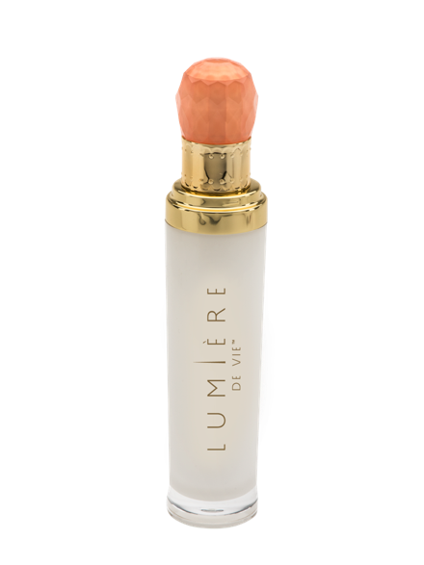
極緻妍亮淡斑液 ILLUMINATING FADING FLUID
主要成份：
Illumiscin
Synovea HR（乙基間苯二酚）
乙醯葡萄糖胺
尿囊素
玻尿酸鈉
KEY INGREDIENTS:
Illumiscin
Synovea HR
Acetyle Glucosamine
Allantoin
Sodium Hyaluronate
Code: HK12203 DC: $350 SR: $490 BV: 35

Slide 12
極緻妍亮淡斑液 ILLUMINATING FADING FLUID
效果：
令肌膚顯著明亮，膚色更年輕、有活力
滋潤肌膚，令肌膚更柔軟、嫩滑
促進健康肌膚微循環，有助維持正常肌膚代謝與營養吸收
Results you can expect:
Dramatically brightens your skin for a more radiant, younger-looking complexion
Moisturizes to give skin a smoother and softer appearance
Promotes healthy skin microcirculation, helps maintain normal skin metabolism and nutrient absorption
Code: HK12203 DC: $350 SR: $490 BV: 35

Slide 13
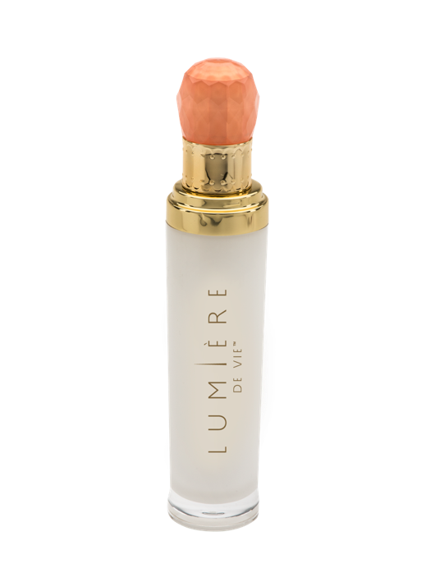
極緻妍亮精華液 SERUM CONCENTRATE
主要成份：
Juvenessence®（海藻萃取物）
Sytenol® A（補骨脂酚）
Synovea® HR（乙基間苯二酚）
雷公根（積雪草）萃取物
四己基癸醇抗壞血酸酯
KEY INGREDIENTS:
Juvenessence® (Algae Extract)
Sytenol® A
Synovea® HR
Centella asiatica Extract
Tetrahexyldecyl Ascorbate
Code: HK12204 DC: $495 SR: $690 BV: 50

Slide 14
極緻妍亮精華液 SERUM CONCENTRATE
效果：
減慢老化過程
支援健康的膠原蛋白水平
減少肌膚色素沉澱
促進膚色剔透明亮
Results you can expect:
Delays in the look of accelerated aging
Supports healthy levels of collagen
Reduces the appearance of hyper-pigmented skin
Promotes a clear-looking complexion
Code: HK12204 DC: $495 SR: $690 BV: 50

Slide 15
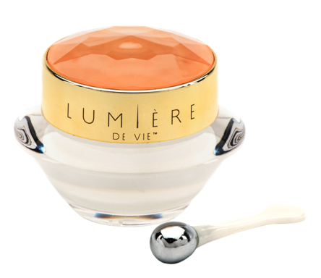
極緻妍亮眼霜
EYE BALM
主要成份：
Pinoxide®
乳木果油
甘油
角鯊烷
KEY INGREDIENTS:
Pinoxide®
Shea Butter
Glycerin
Squalane
Code: HK12200 DC: $240 SR: $335 BV: 23

Slide 16
極緻妍亮眼霜
EYE BALM
效果：
減淡黑眼圈
緊緻眼底肌膚
支援肌膚彈性
加入柔光因子，使眼周肌膚細緻無瑕
Results you can expect:
Reduces the appearance of under eye dark circles
Promotes under-eye skin firmness
Supports the resiliency of skin
Light-diffusing pigments promote a flawless-looking appearance
Code: HK12200 DC: $240 SR: $335 BV: 23

Slide 17
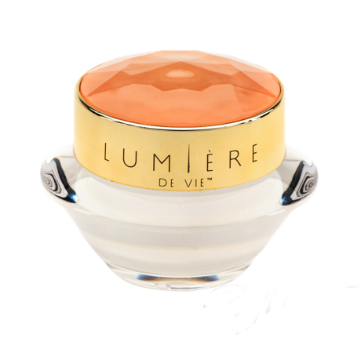
極緻妍亮逆齡面霜
INTENSE REJUVENATION CRÈME
主要成份：
五胜肽(Matrixyl synthe’6™)
Sytenol A（補骨脂酚）
GranactiveAR-1423
甘油
乙醯葡萄糖胺
KEY INGREDIENTS:
Matrixyl® synthye’6
Sytenol A
GranactiveAR-1423
Glycerin
Acetyl Glucosamine
Code: HK12201 DC: $350 SR: $490 BV: 35

Slide 18
極緻妍亮逆齡面霜
INTENSE REJUVENATION CRÈME
肌膚明亮度顯著提升
膚色改善，促進健康肌膚彈性與緊緻度
促進健康膠原蛋白製造
Significant increase in skin radiance and brightness
Improves the appearance of skin tone, promotes healthy skin elasticity and firmness
Promotes healthy collagen production
Code: HK12201 DC: $350 SR: $490 BV: 35

Slide 19
極緻妍亮逆齡面霜
INTENSE REJUVENATION CRÈME
促進熱休克蛋白（環境壓力因素）的正常活動
促進肌膚正常修復
促進正常玻尿酸製造
Promotes the normal function of heat shock proteins (environmental stressors)
Promotes normal skin healing
Promotes normal Hyaluronic acid production
Code: HK12201 DC: $350 SR: $490 BV: 35

Slide 20
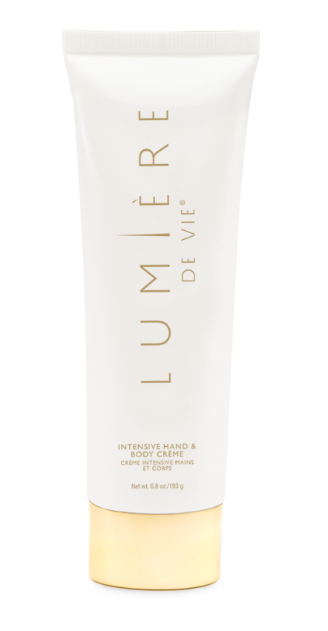
極緻妍亮手部及身體潤膚霜
HAND & BODY CRÈME
主要成份：
乳木果油
葵花籽油
椰子油
KEY INGREDIENTS
Butyrospermum Parkii (Shea Butter)
Helianthus Annuus (Sunflower) Seed Oil
Cocos Nucifera (Coconut) Oil
Code: HK12205 DC: $180 SR: $251 BV: 17

Slide 21
極緻妍亮手部及身體潤膚霜
HAND & BODY CRÈME
效果：
滋潤肌膚，改善肌膚粗糙和乾燥外表
含乳木果油、椰子油和葵花籽油，令肌膚外表柔軟嫩滑
易於被肌膚吸收，而不會感覺油膩
RESULTS YOU CAN EXPECT:
Moisturizes to reduce the appearance of rough, dry skin
Contains shea butter, coconut oil and sunflower seed oil to keep skin looking soft and smooth
Absorbs into skin so it does not feel greasy
Code: HK12205 DC: $180 SR: $251 BV: 17

Slide 22
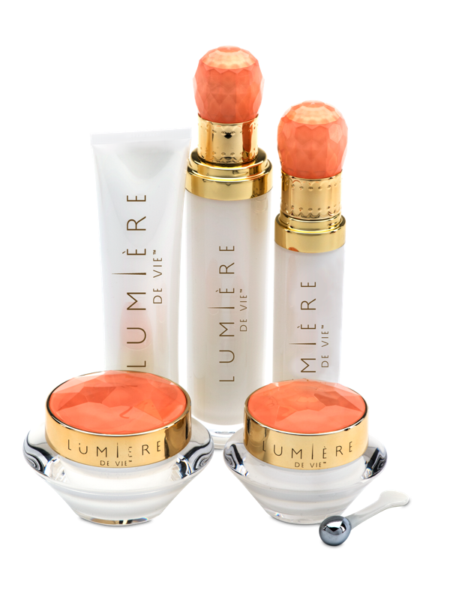
顯著效果
AMAZING RESULTS

Slide 23
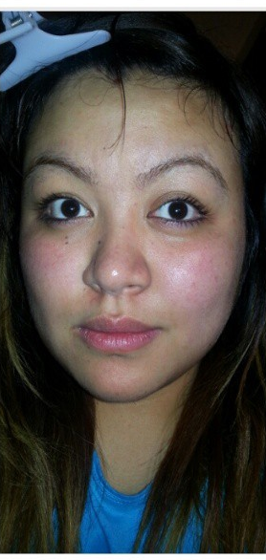
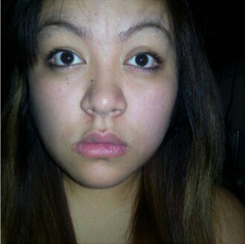
使用前Before
3日後
3 days

Slide 24
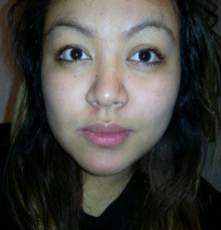
使用前Before
1週後
1 week

Slide 25
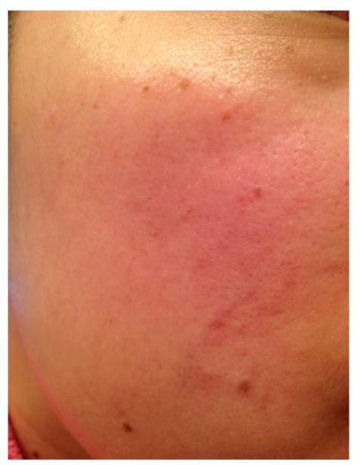
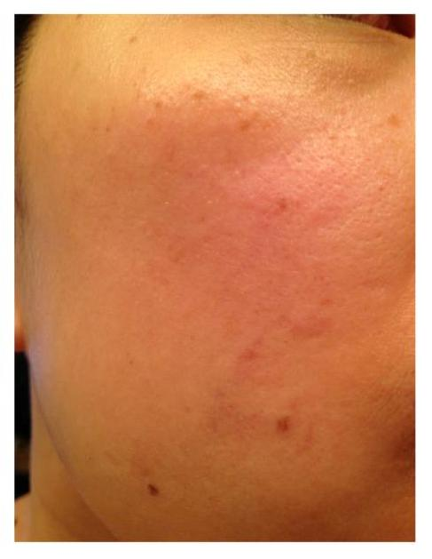
使用前
Before
使用後
After

Slide 26
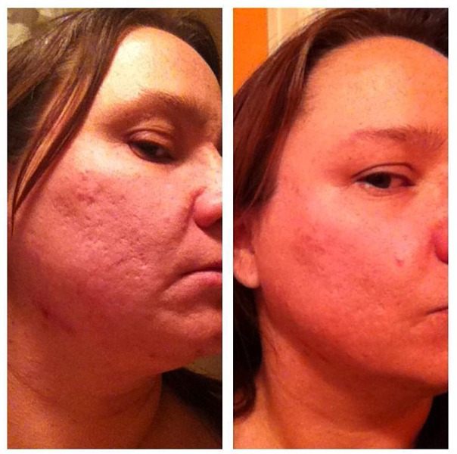
使用前
Before
使用後
After

Slide 27
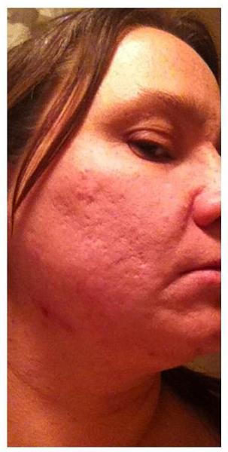
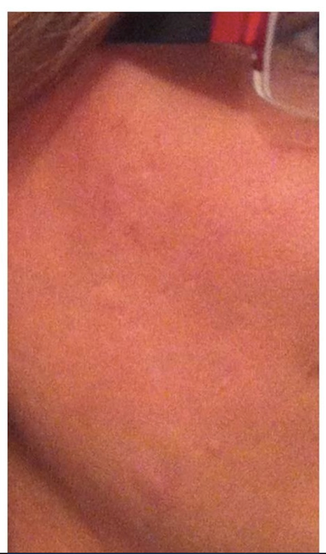
使用前
Before
使用後
After-After

Slide 28
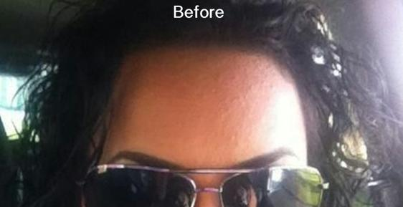
使用前
Before
使用後
After

Slide 29
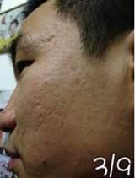
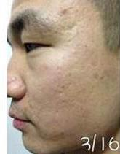
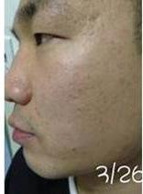
使用前
Before
1週後
1 Week

Slide 30
使用前
Before
2週後
2 Weeks

Slide 31
每個人都渴望體驗…
Everyone Wants This…

Slide 32
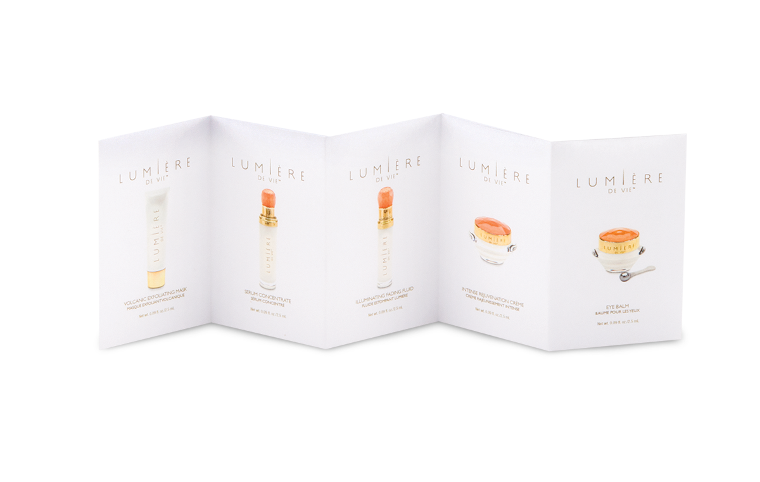
試用裝 TANDEMS
(SAMPLE PACKS)
Code: HK12206 DC: $210 BV: 0

Slide 33
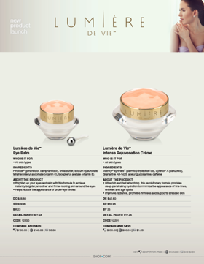
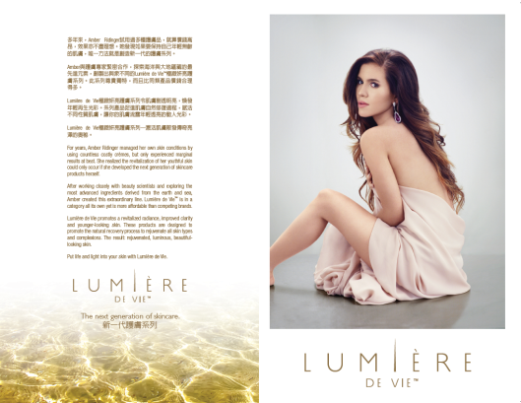
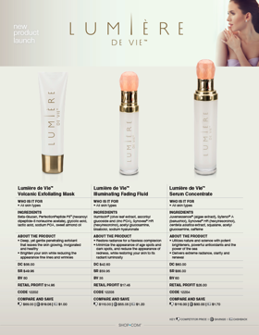
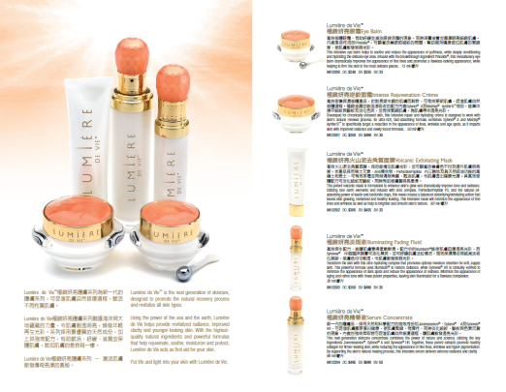
護膚圖表
Lumiere de Vie™ 極緻妍亮護膚系列
銷售輔助工具 － 現已推出
Sales Aids – Available NOW!
護膚程序
REGIMEN HANDOUT
ON UF.com
宣傳單張可供下載
Handouts
Available on Downloads
Skincare Chart

Slide 34
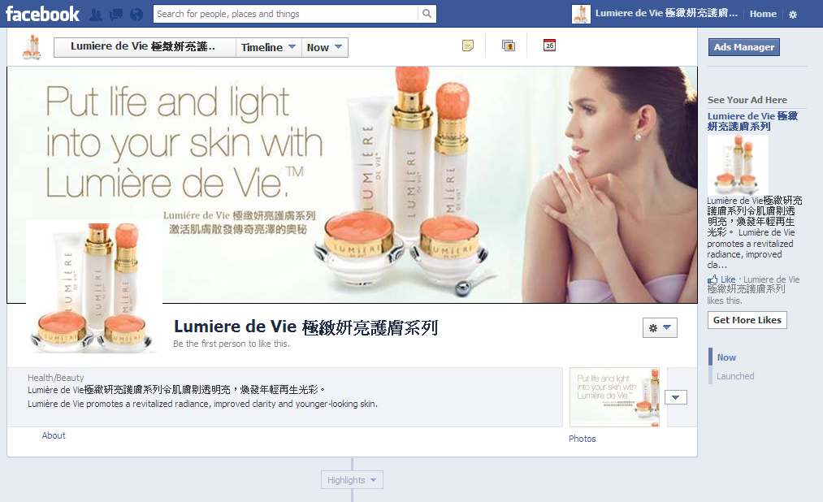
緊貼Lumière de Vie極緻妍亮護膚系列最新資訊
Stay Connected with Lumière de Vie https://www.facebook.com/Lumieremhk

Slide 36
.
Notes:
36

